Slide 1
Predicting Diabetes Risk Using Patient Health Indicators
DSC 680 – Applied Data Science, Fall 2025
Presented by Serge Nane

Slide 2
Introduction
Key point:
Diabetes is a major chronic disease-causing severe complications such as heart disease, kidney failure, and blindness.
Goal:
The goal of this project is to apply machine learning techniques to predict the onset of diabetes using patient health indicators.
Stakeholders:
The project is relevant to patients, healthcare providers, and public health systems because early detection can reduce costs and improve outcomes.

Slide 3
Data Overview
Dataset: Pima Indians Diabetes Database (UCI/Kaggle).
Contains 768 female patients of Pima Indian heritage.
Includes 8 predictor features (pregnancies, plasma glucose concentration, diastolic blood pressure, triceps skinfold thickness, serum insulin, body mass index (BMI), diabetes pedigree function, and age) and 1 binary outcome variable (0 = non-diabetic, 1 = diabetic).
Challenge: The dataset is relatively small and imbalanced (~35% positive cases).

Slide 4
Data Preparation
Missing values: Zero entries in glucose, insulin, and skin thickness were treated as missing and replaced with median values.
Feature scaling: Continuous features were standardized for consistency across models.
Balancing: SMOTE (Synthetic Minority Oversampling Technique) was applied to address class imbalance and improve model recall.

Slide 5
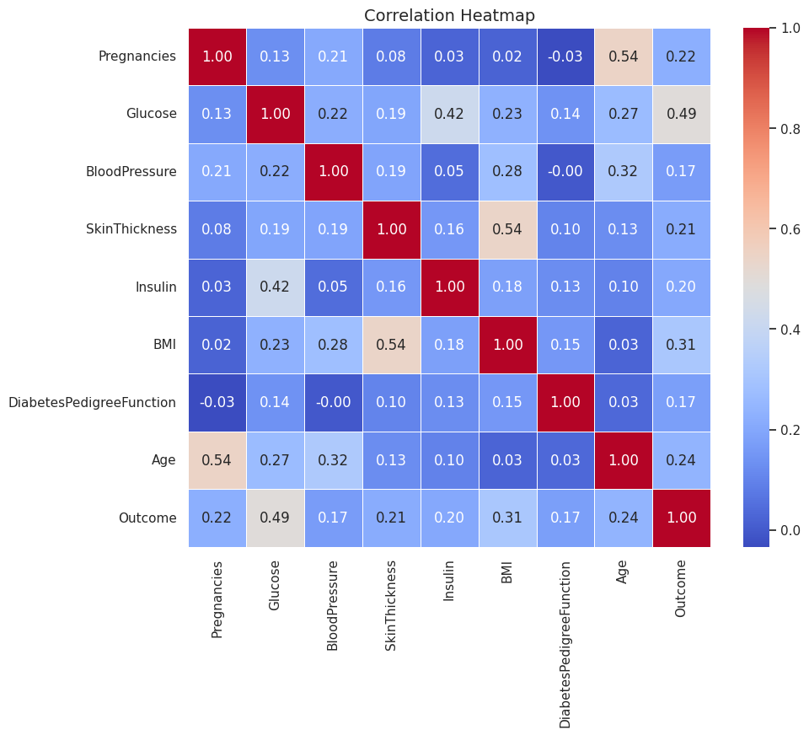
Exploratory Insights
1. Correlation analysis revealed Glucose, BMI, and Age as the strongest predictors of diabetes outcome.
2. The dataset shows more non-diabetic cases compared to diabetic cases.

Slide 6
Modeling Approaches
Logistic Regression: Provided a linear baseline model.
Decision Tree: Simple and interpretable but prone to overfitting.
Random Forest: Ensemble method, improved accuracy and robustness.
XGBoost: Gradient boosting algorithm, powerful for imbalanced datasets, and achieved the best results.

Slide 7
Results Summary
Model | Accuracy | Precision | Recall | F1-Score | ROC-AUC
Logistic Regression | 0.71 | 0.58 | 0.67 | 0.62 | 0.811
Decision Tree | 0.70 | 0.57 | 0.61 | 0.59 | 0.681
Random Forest | 0.75 | 0.63 | 0.72 | 0.67 | 0.814
XGBoost | 0.73 | 0.60 | 0.65 | 0.62 | 0.808

Slide 8
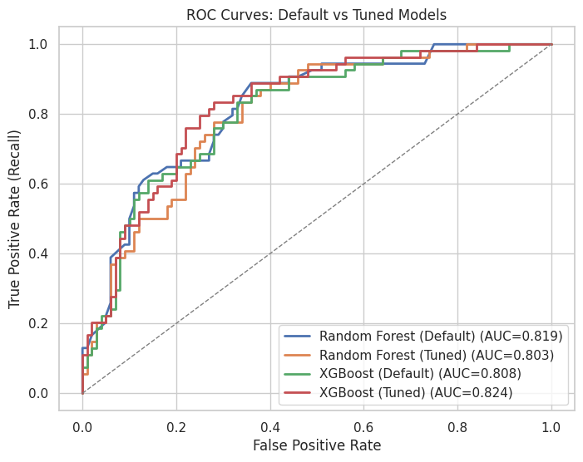
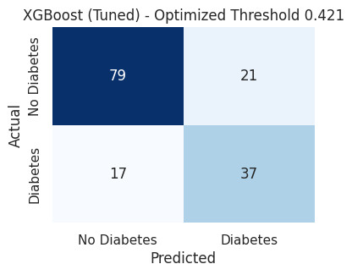
Visualizations results

Slide 9
Feature Importance
Random Forest results emphasized Glucose as the dominant predictor.
XGBoost distributed importance more evenly across Glucose, BMI, and Age, improving generalization.

Slide 10
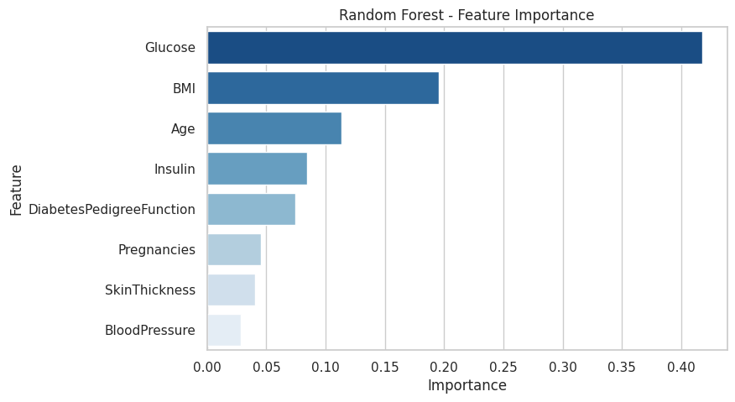
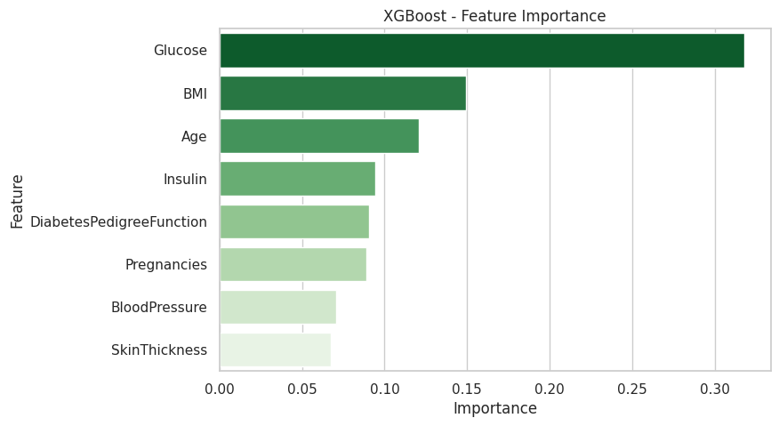
Visualizations

Slide 11
Conclusion
XGBoost outperformed other models and demonstrated strong predictive ability for diabetes risk.
Key predictors included Glucose, BMI, and Age.
Limitations: small dataset size, limited generalizability.
Future work: apply models to larger datasets, incorporate lifestyle data, and adopt SHAP for interpretability.

Slide 12
Ethical Considerations
Patient data privacy must be protected even when anonymized.
Fairness: models must be evaluated for biases against demographic groups.
Interpretability: clinicians should be able to trust and understand predictions.
The model is designed to support clinical judgment, not replace it.

Slide 13
Thank You!

